Slide 1
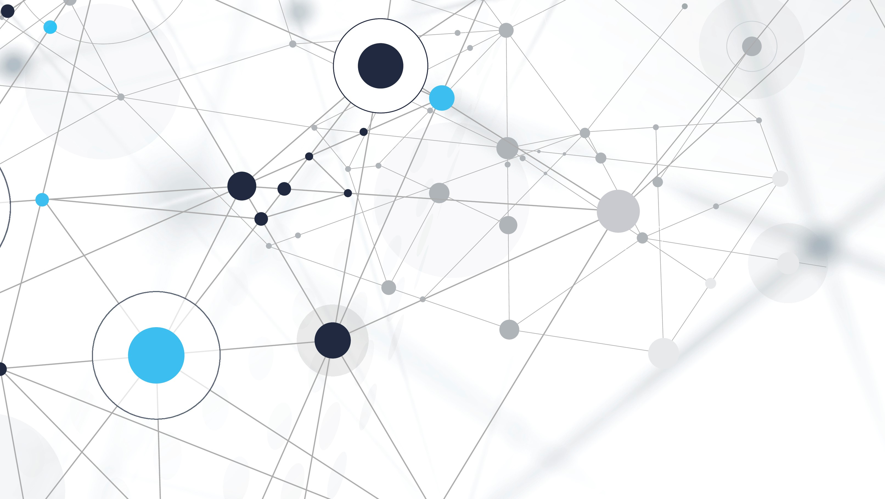
IOT - development of home automation system
Ooi Kok Yih

Slide 2
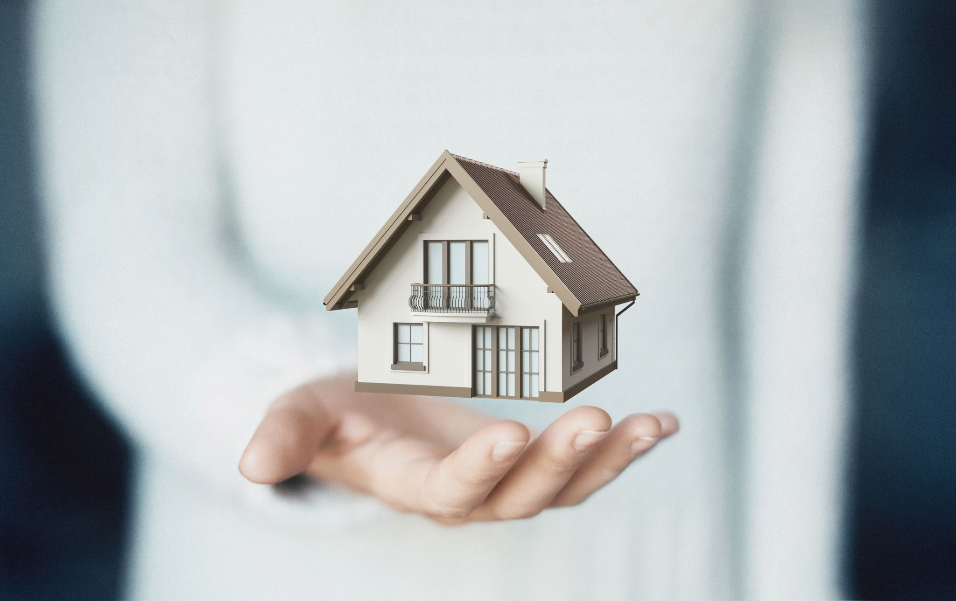
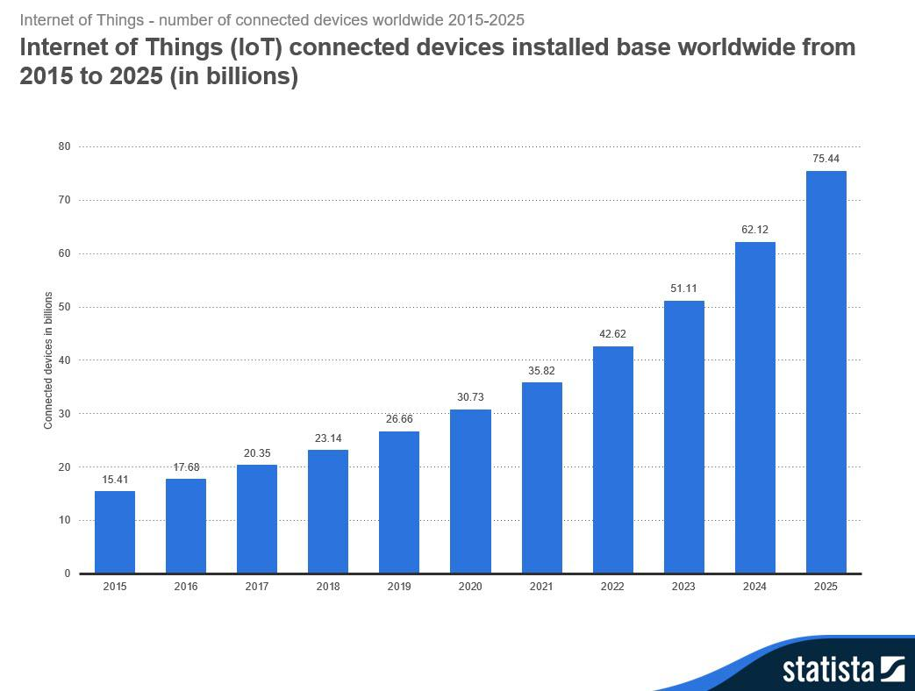
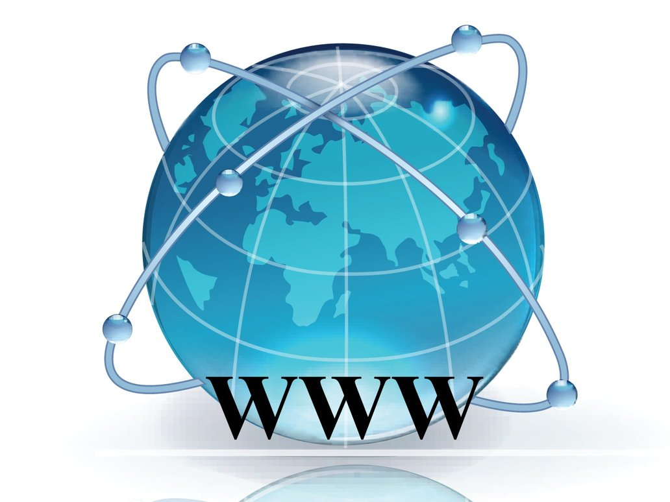
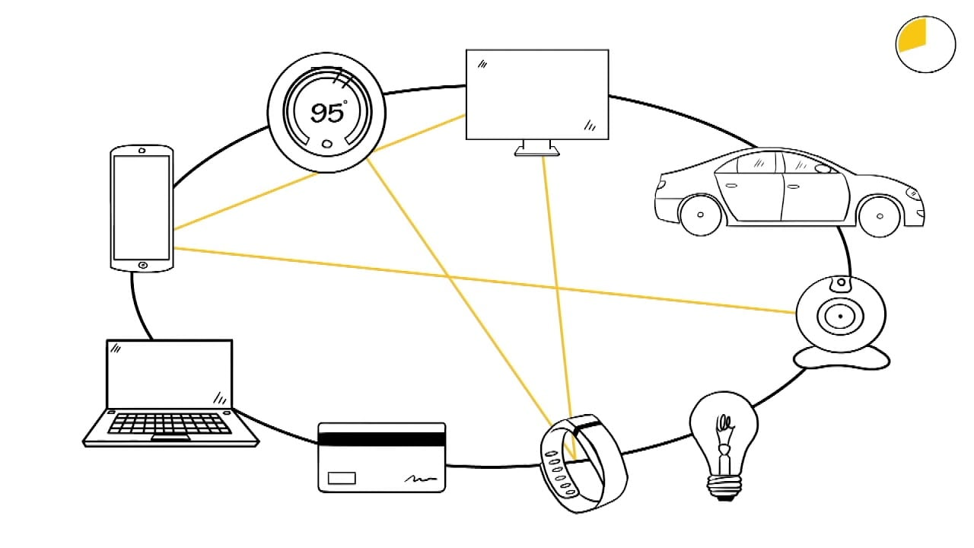
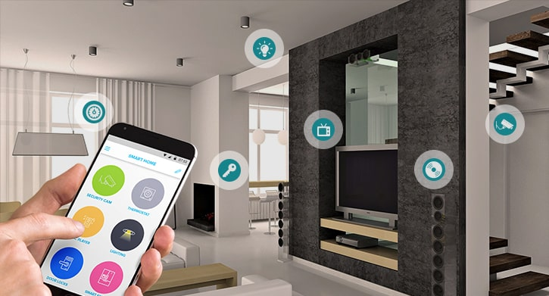
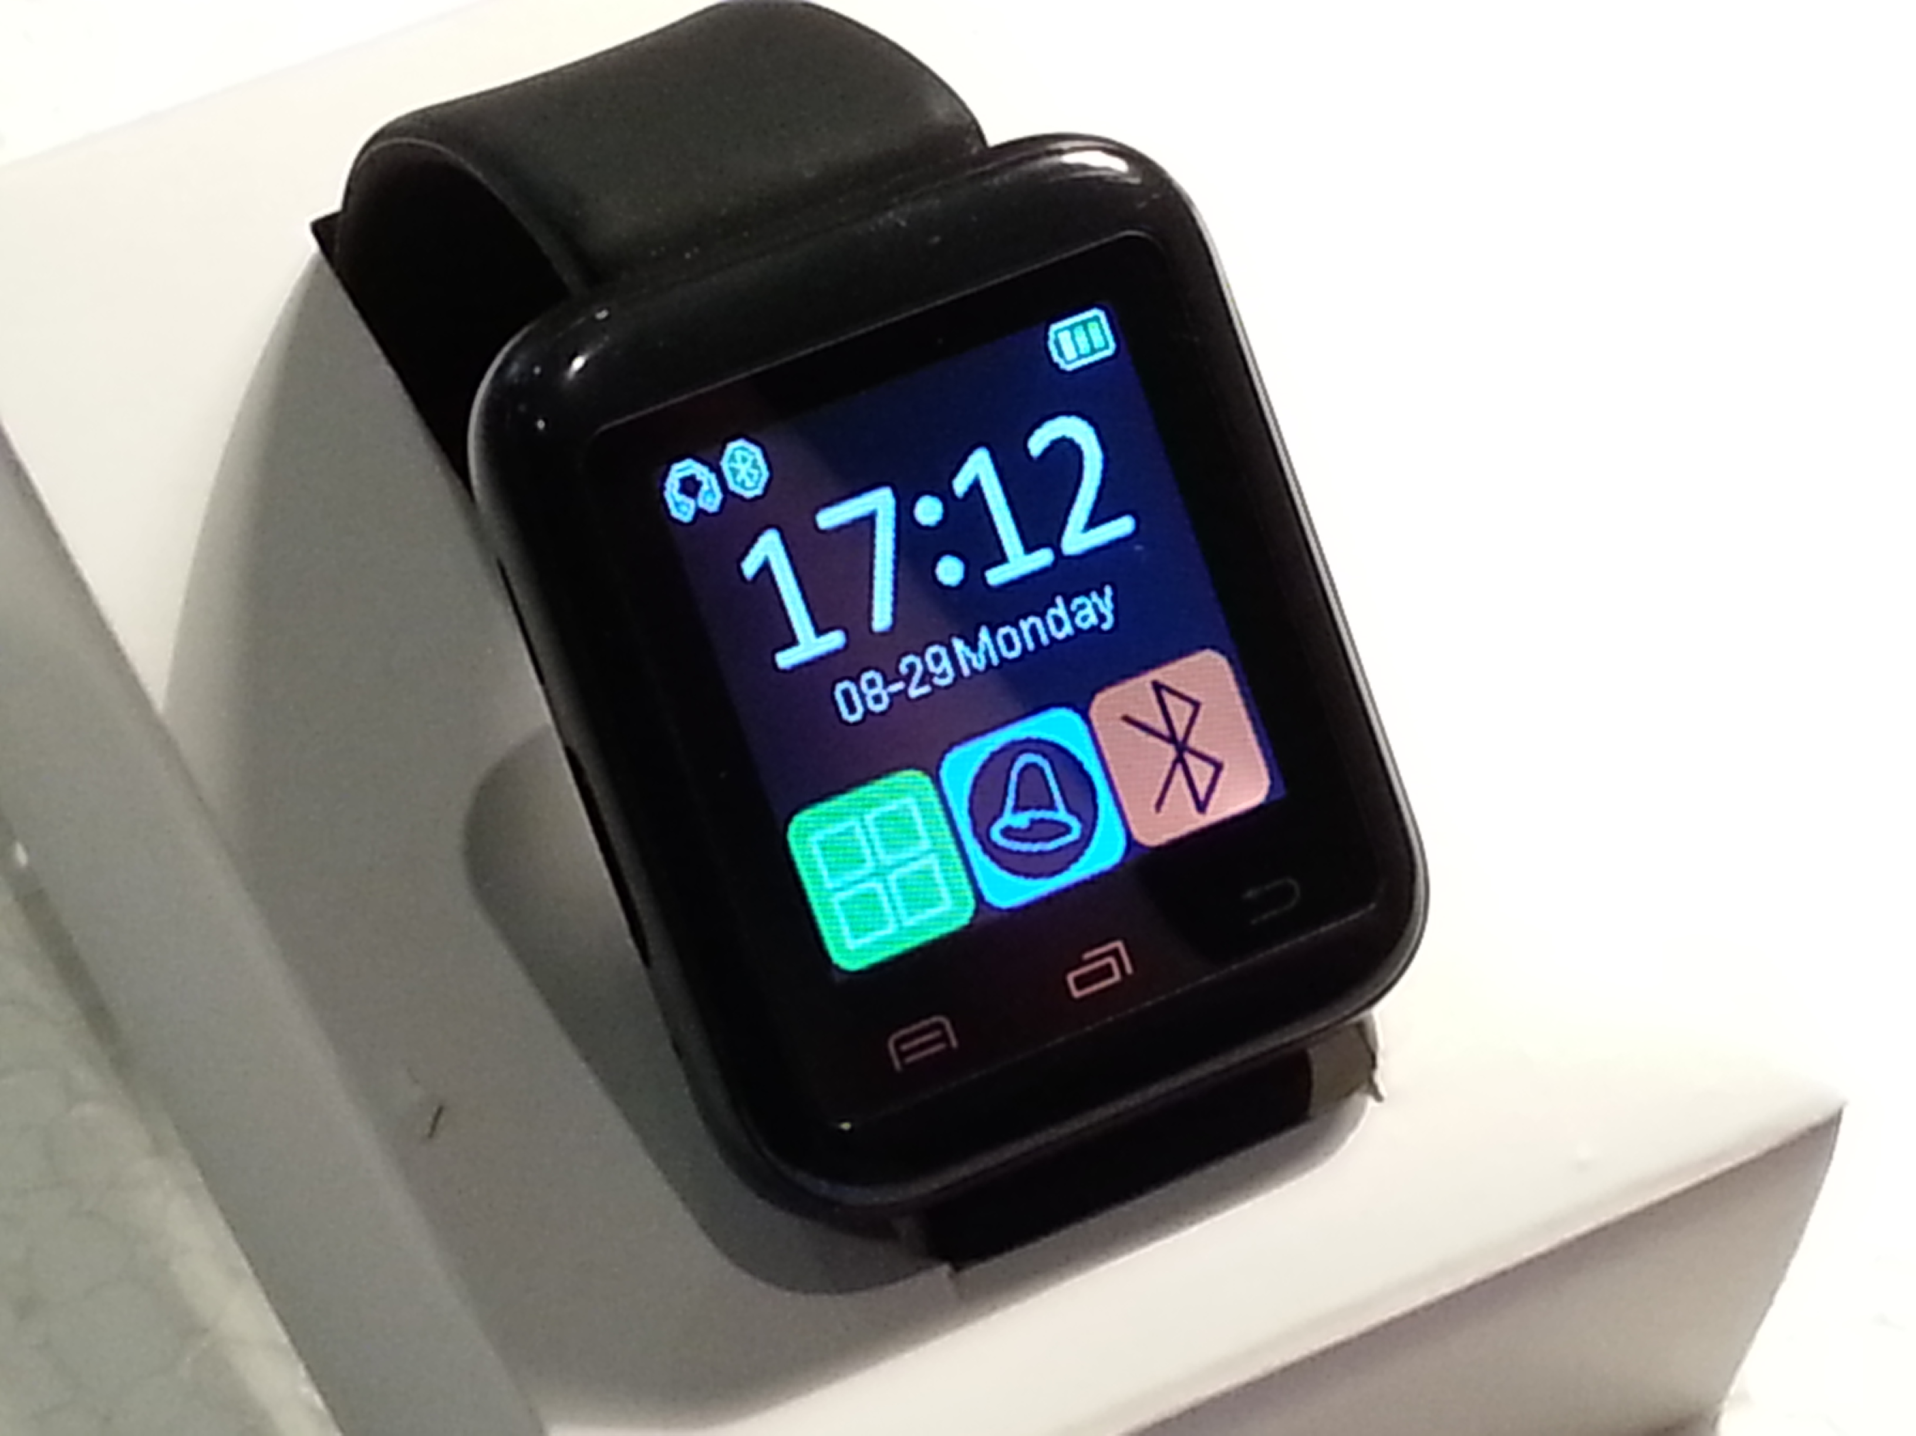
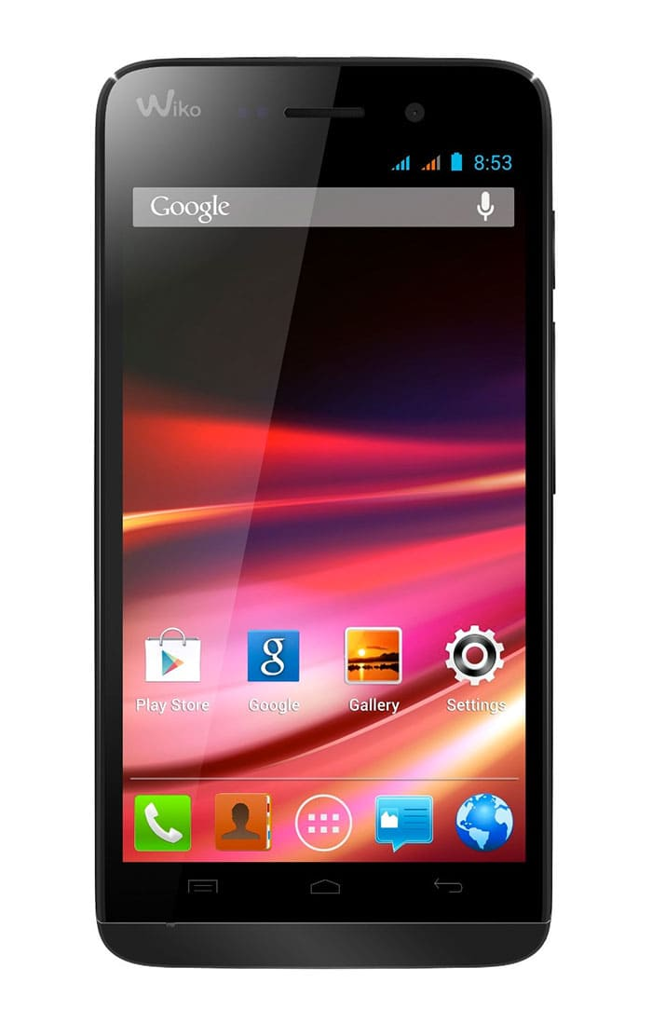


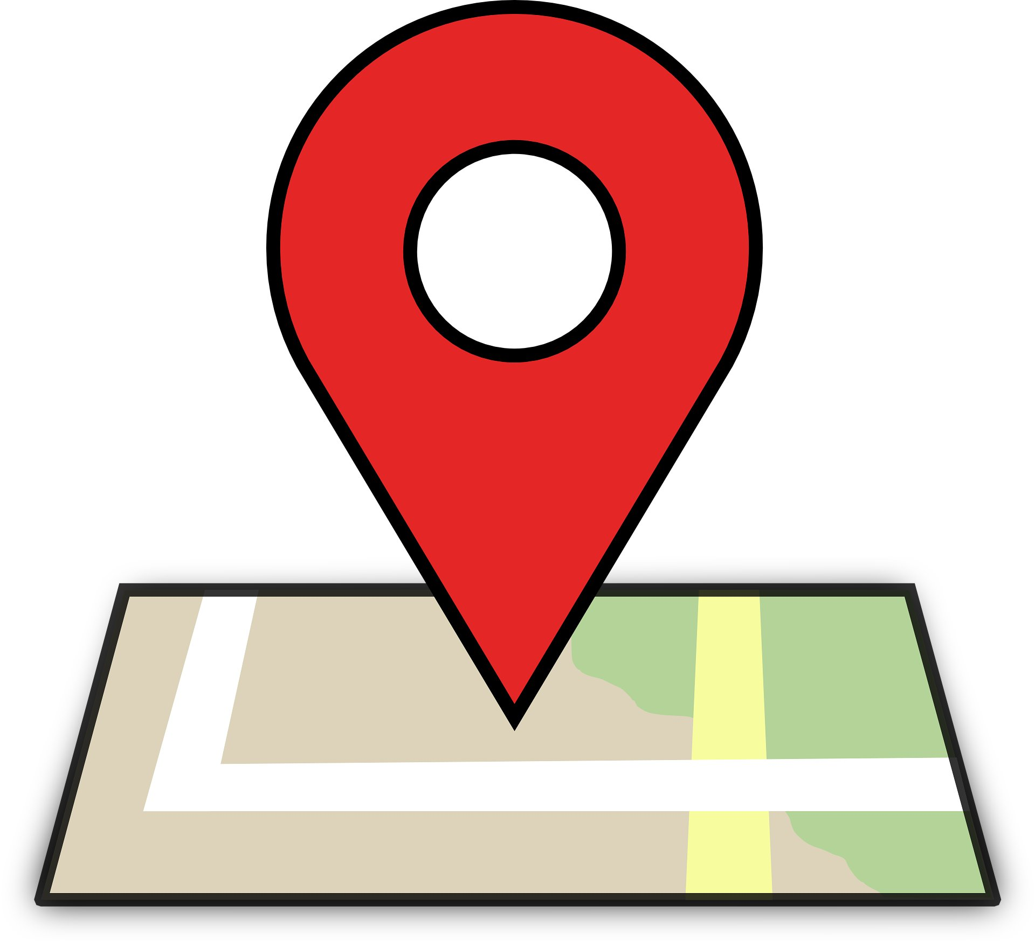
IOT & home automation
Reference: https://www.statista.com/statistics/471264/iot-number-of-connected-devices-worldwide/
Notes:
Iot – embedded systems that are able to exchange data
for example, a watch….
In fact, it can be found in many things around us
Image it in your house
This concept is so popular that it is estimated to go up to 75 billion devices connected by 2025

Slide 3
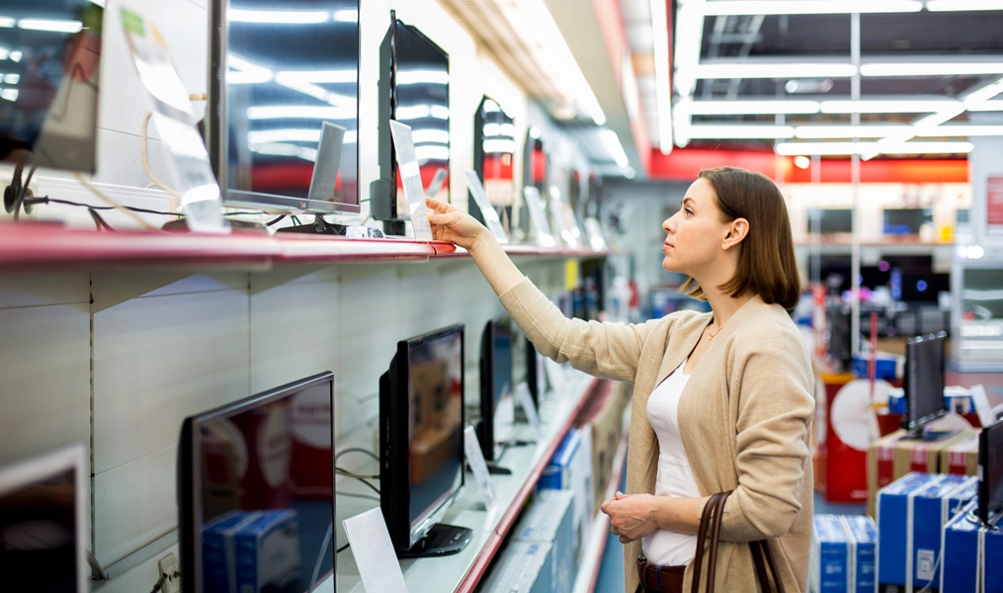
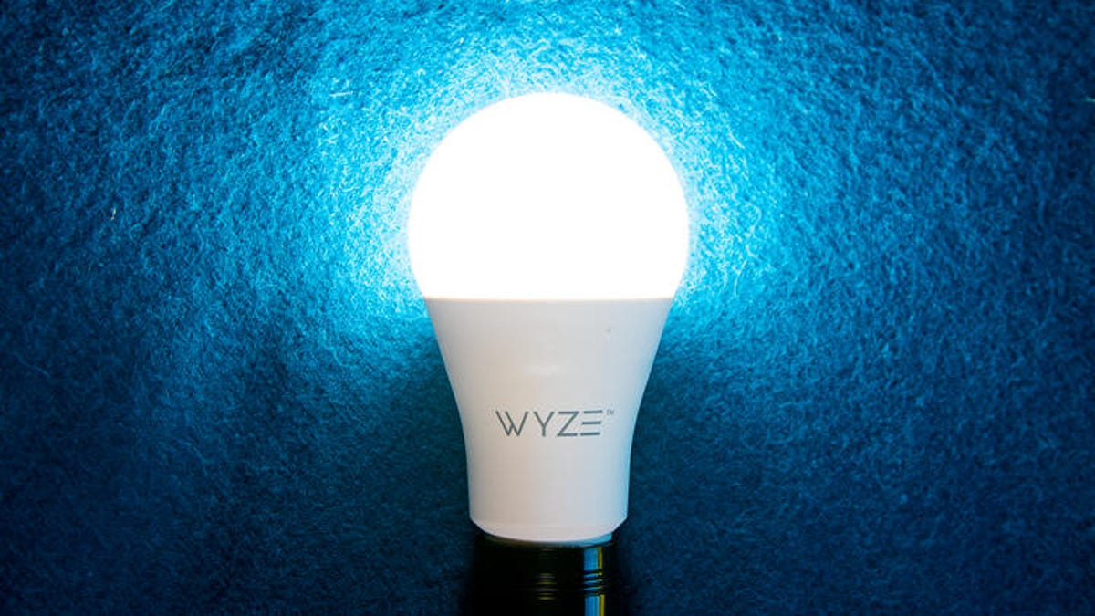
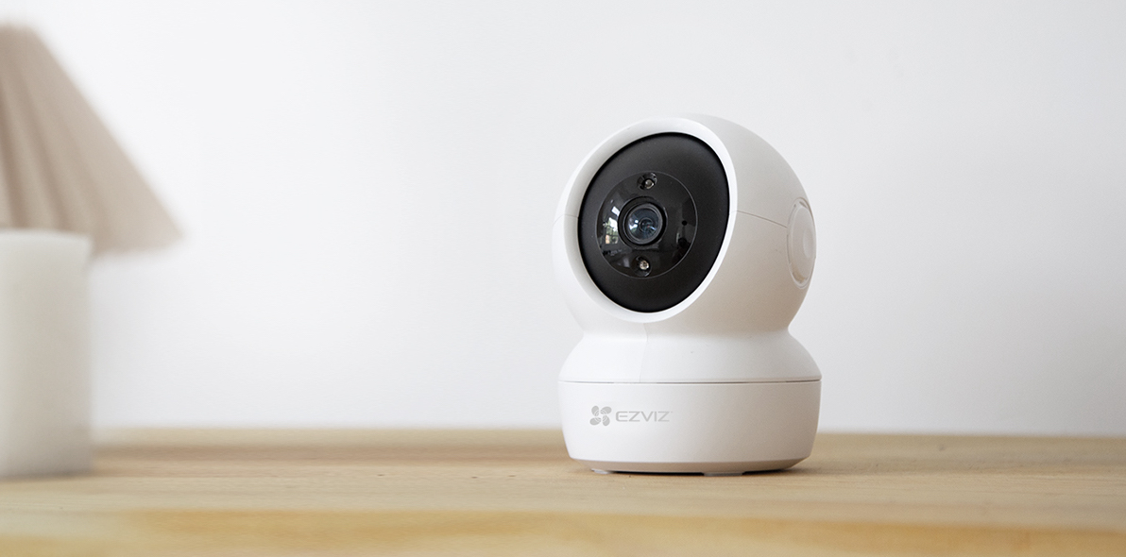
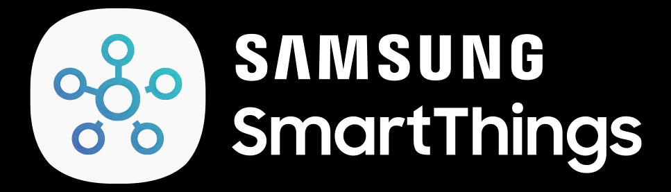
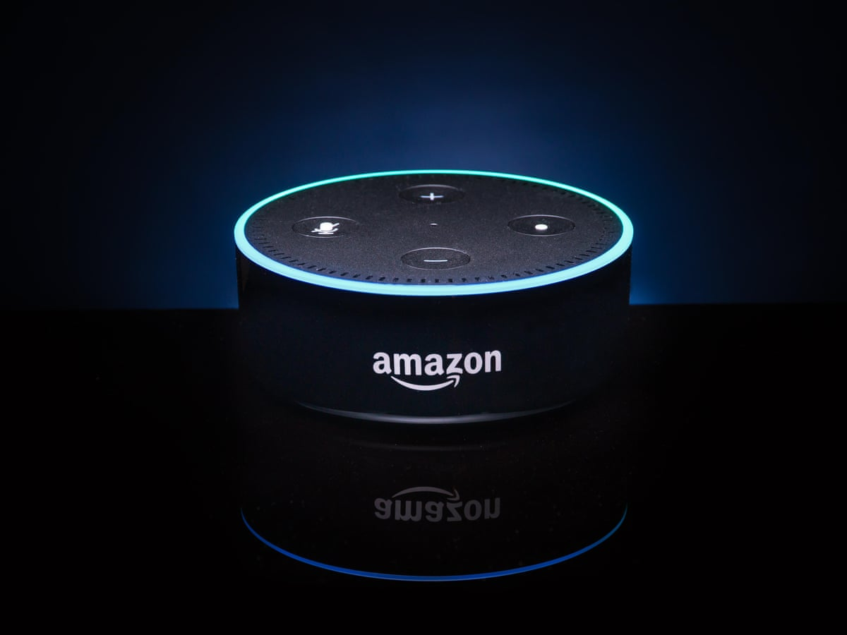
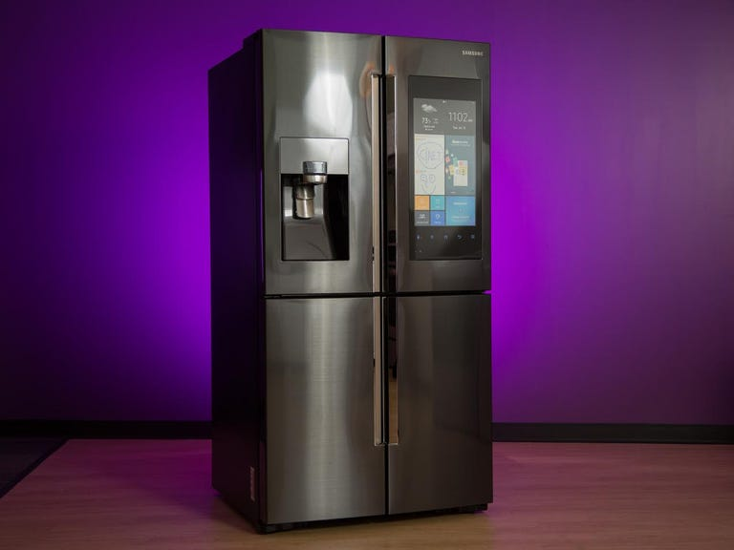
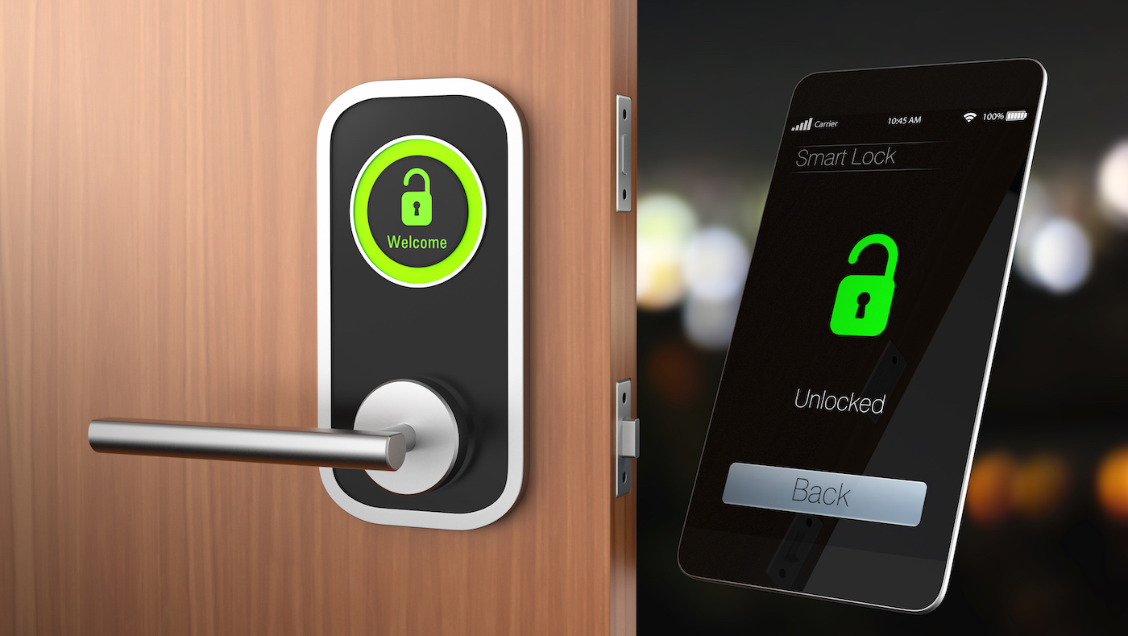
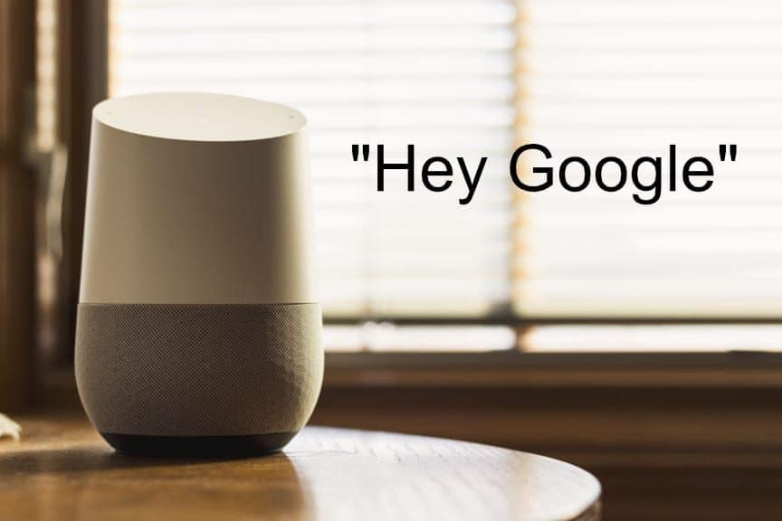
What’s in the market?
Notes:
Lets take a look at whats available today
These are known as control hubs. They mainly control any devices connected to them
And then u purchase a bunch of “smart” appliances to link to these control hubs

Slide 4




What about those old appliances?
Notes:
They still have the basic functions
Just no internet access
Common option is to just throw them away

Slide 5
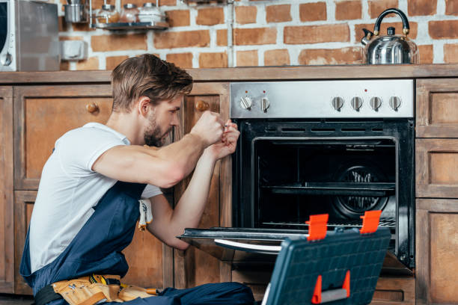


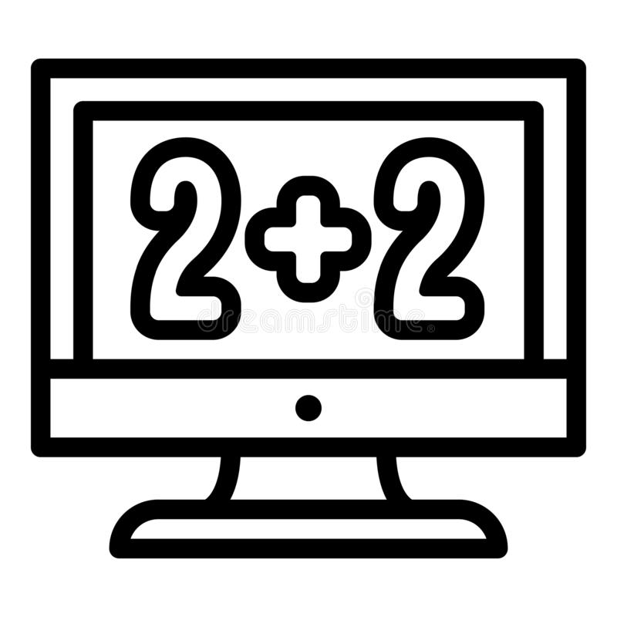
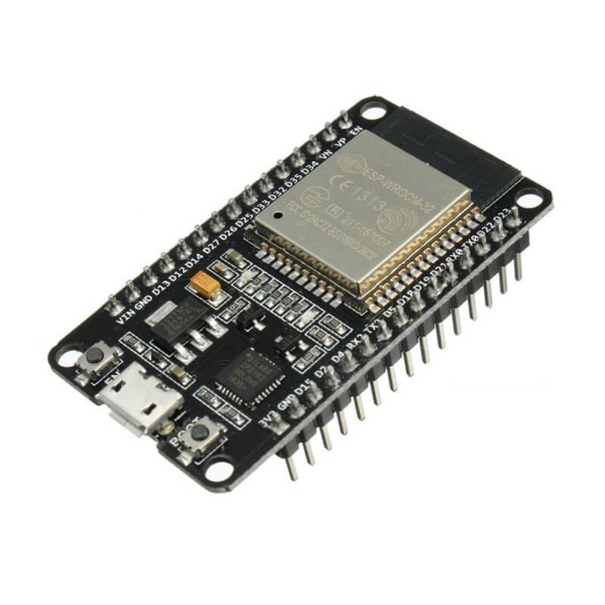
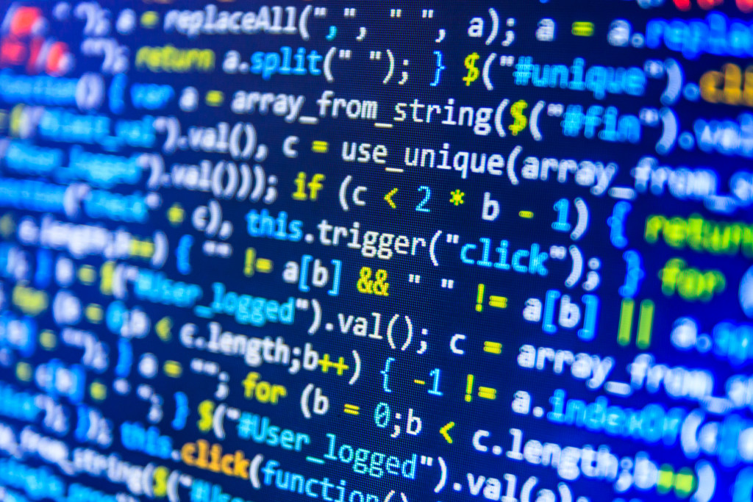

upgrade them!!!
Notes:
What if we upgrade them
Install a microprocessor capable of accessing the internet
Develop our own software

Slide 6
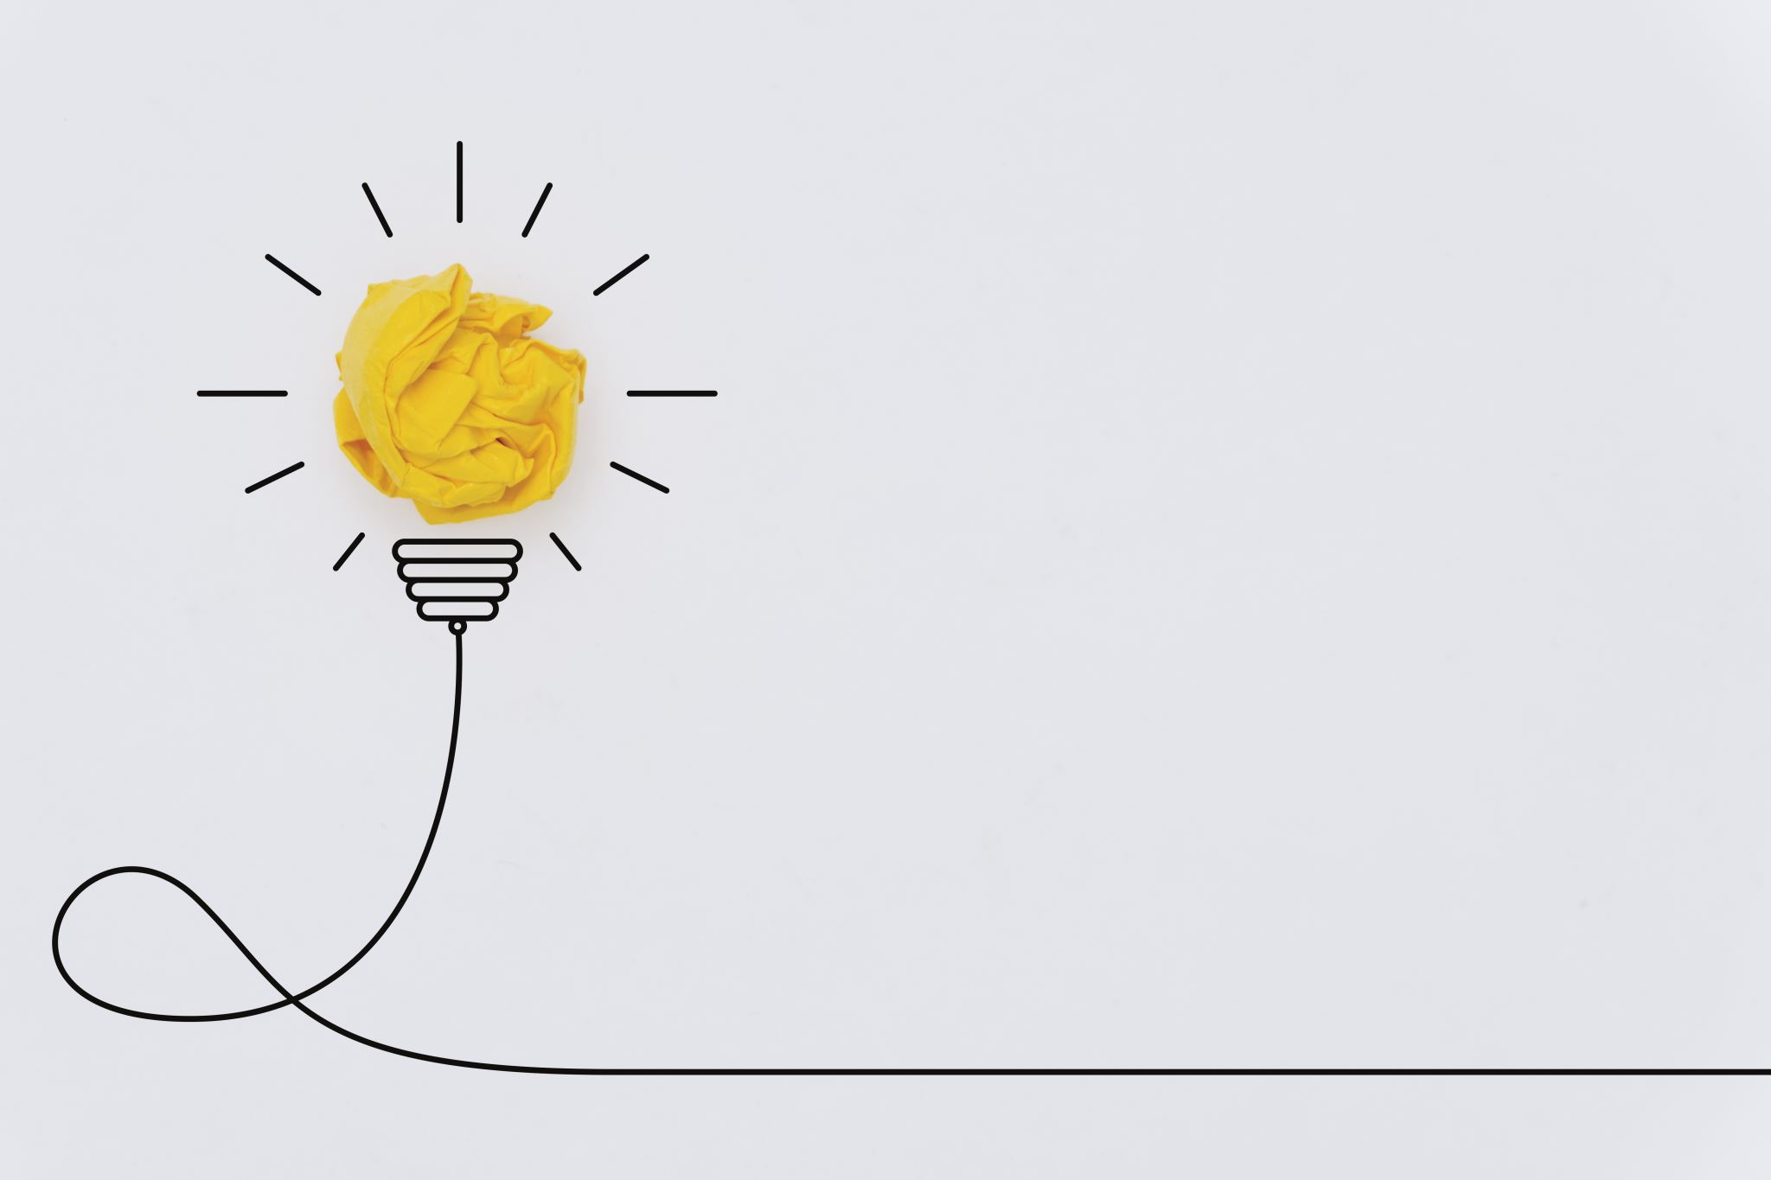
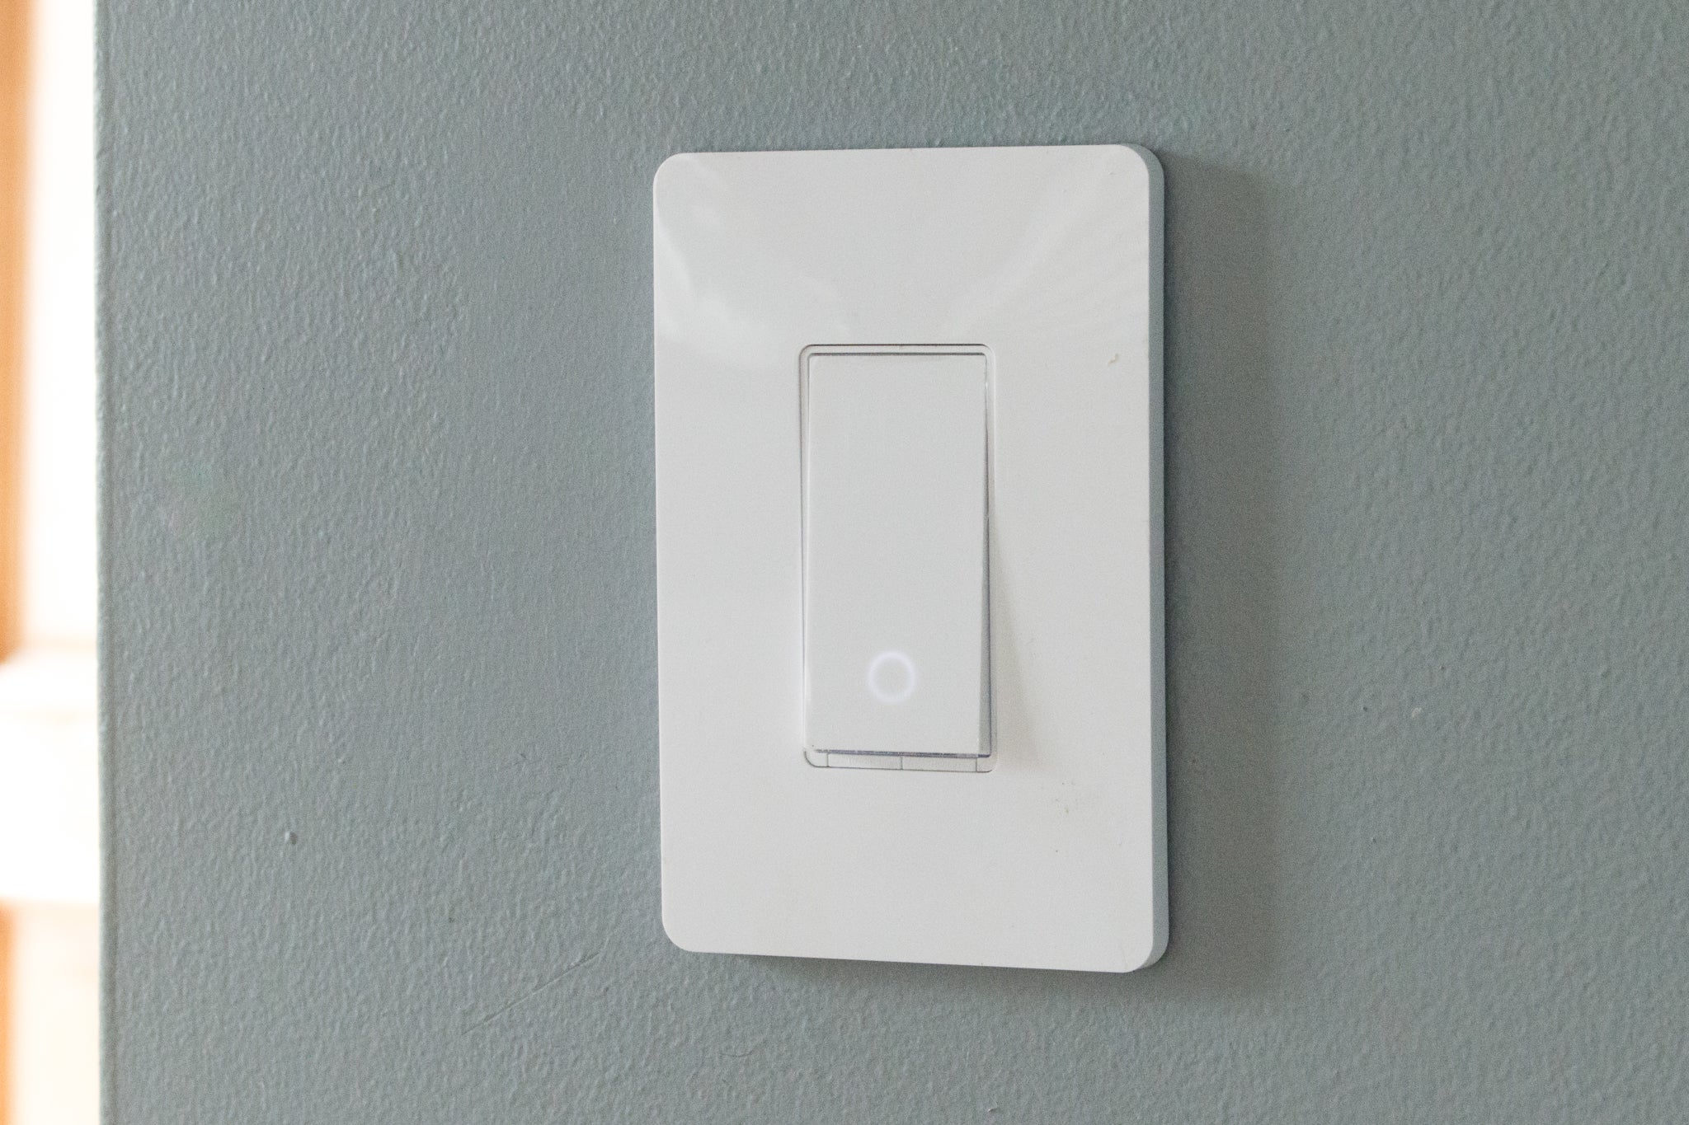
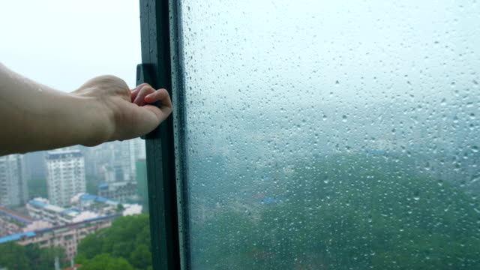
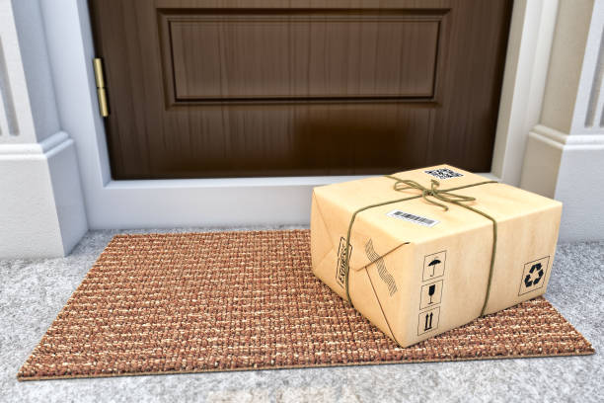
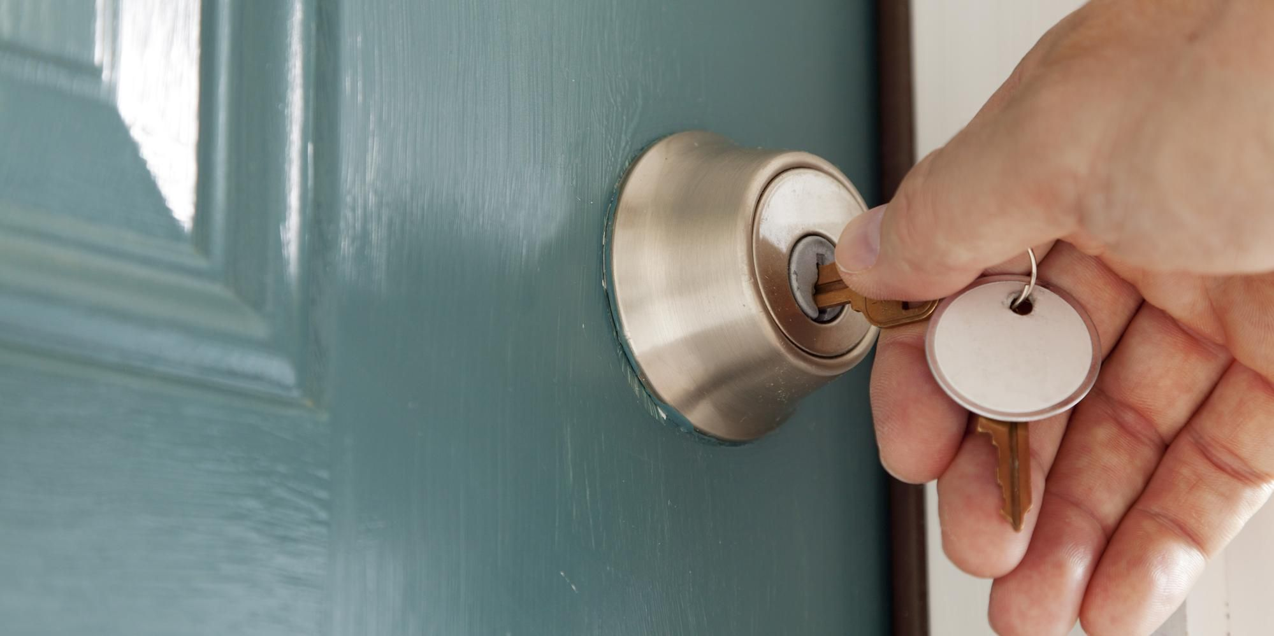
My Ideas…
Notes:
That’s MY goal in this project
Most of my designs revolves around my personal experience living at home
Ever since the covid pandemic, learning from home has become a norm.
While watching lectures…

Slide 7
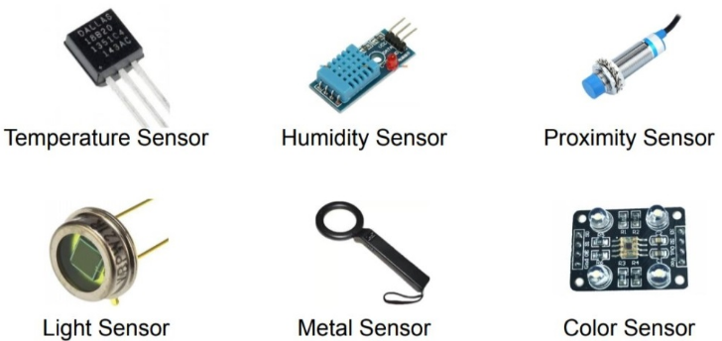
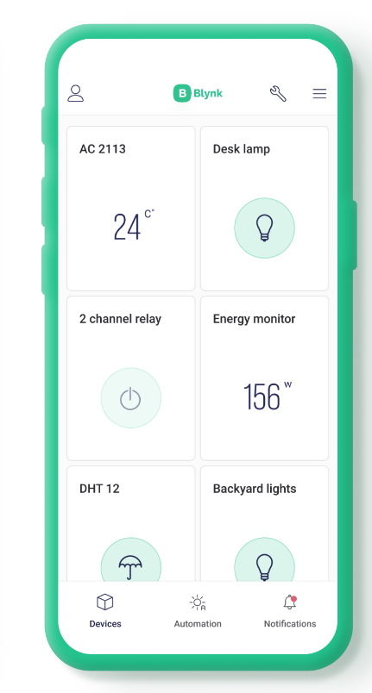

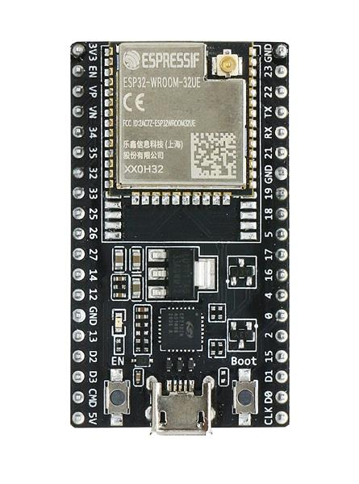
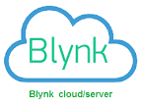
implementation
Existing Household Appliances
ESP32 Microprocessor
Blynk Server
Blynk App on Phone
Notes:
The concept is as follows….

Slide 8
Notes:
Speaking of blynk, Blynk is a IoT platform for android and ios
It was used in this project to server as a medium for data transfer and control between the devices
Comes with a web dashboard so u can also control with your computer
Assign virtual pin
Generate token
Link device and design mobile dashboard

Slide 9
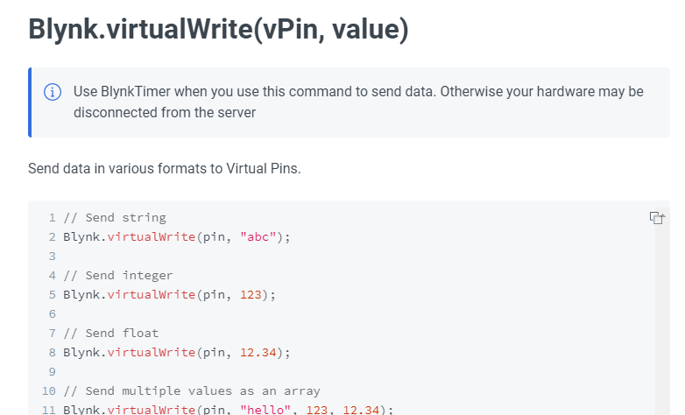
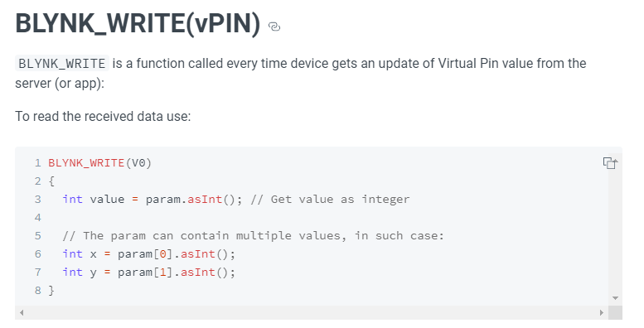
Notes:
The main functions used to read and write data

Slide 10

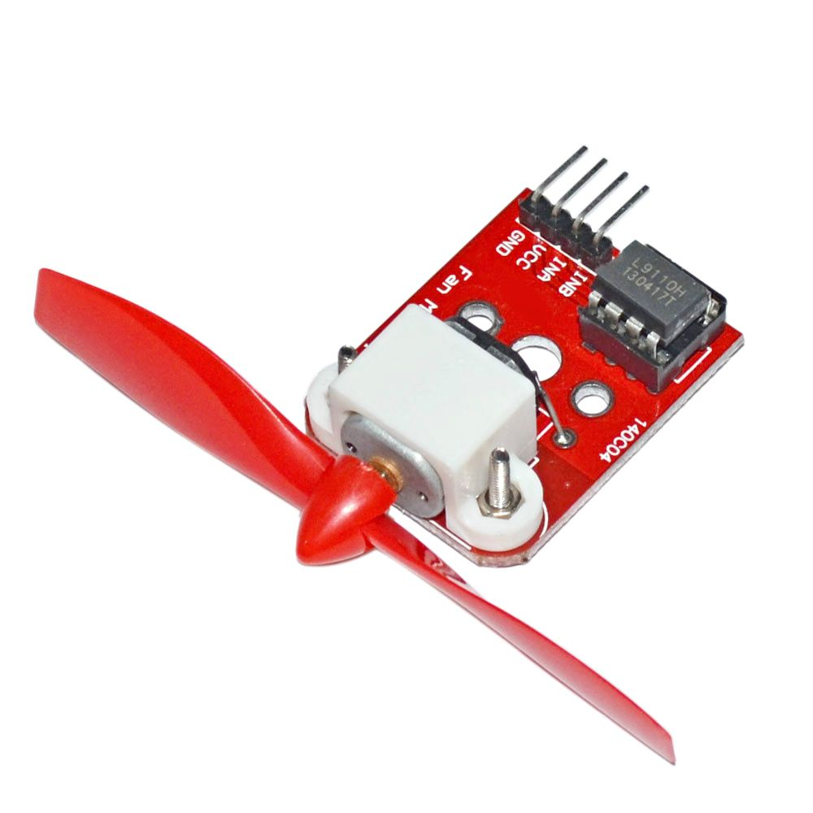
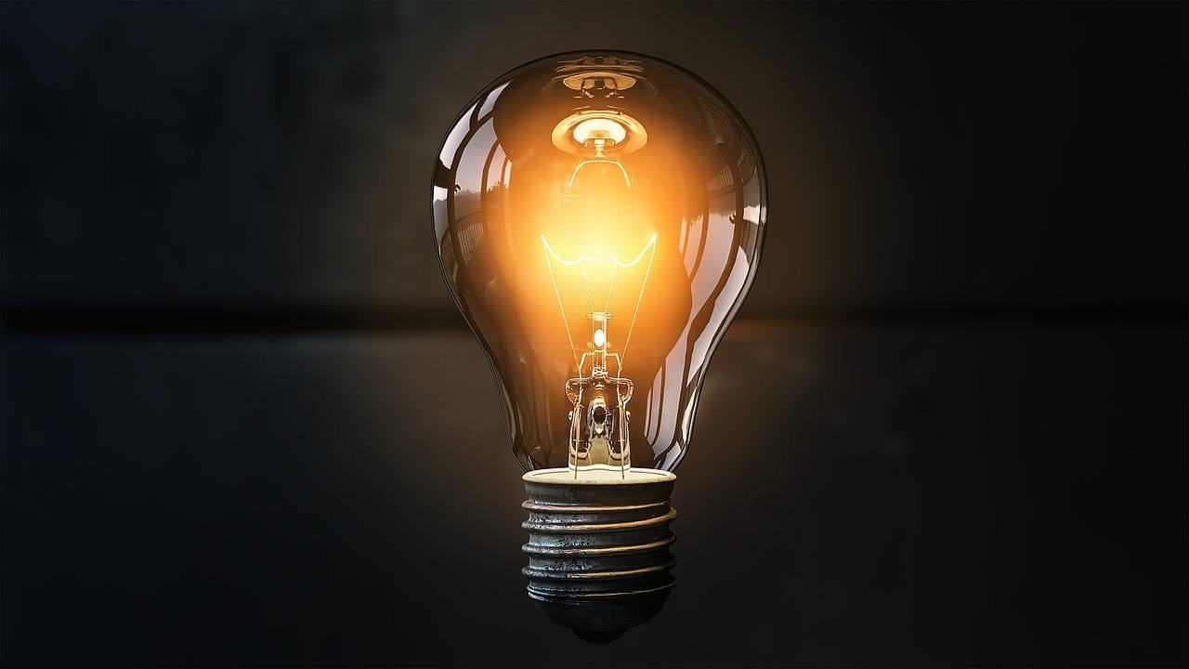
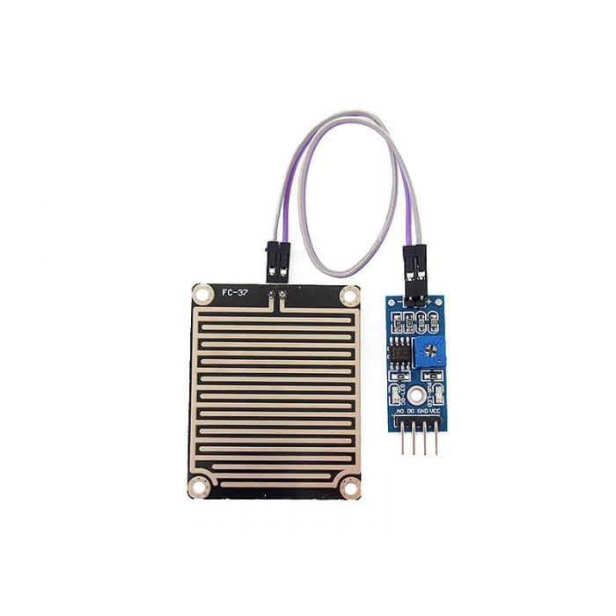
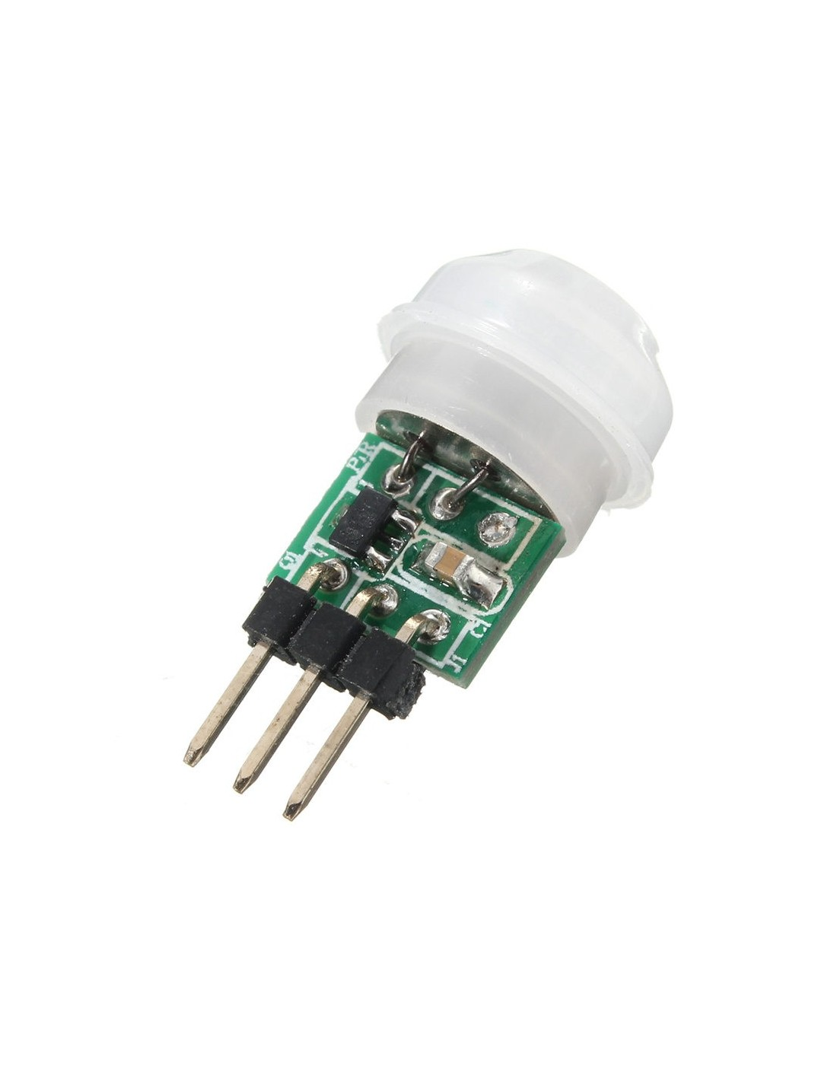

Idea 1 - Room simulation
Notes:
My first idea was to automate my fans and lights as my switches are pretty far away from desk
I also tend to forget to turn them off (motion sensor)
Did not notice rain because of listening to lectures (rain sensor + notification)

Slide 11
Notes:
Controlling light and fan with phone

Slide 12
Notes:
With motion sensor

Slide 13
Notes:
Rain alert

Slide 14

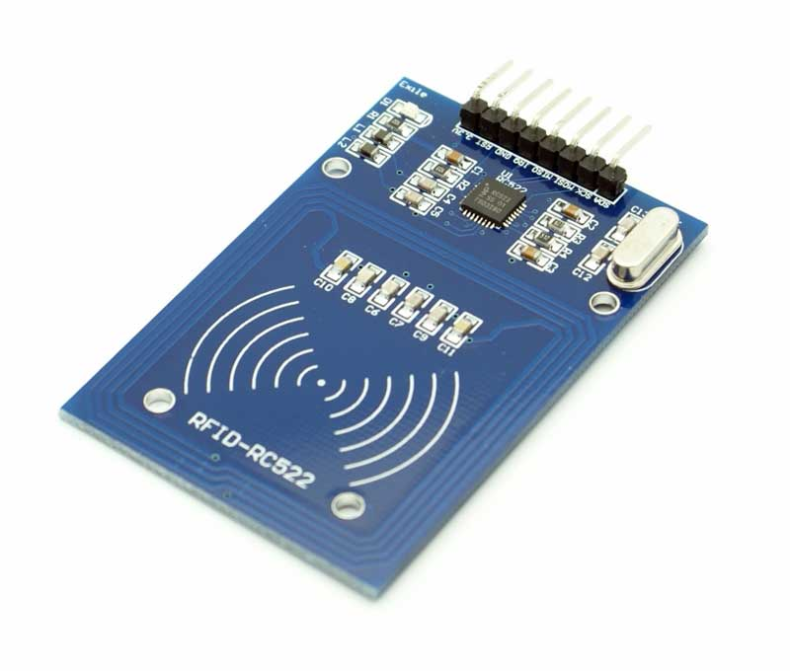
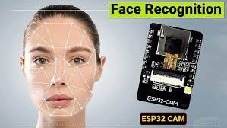
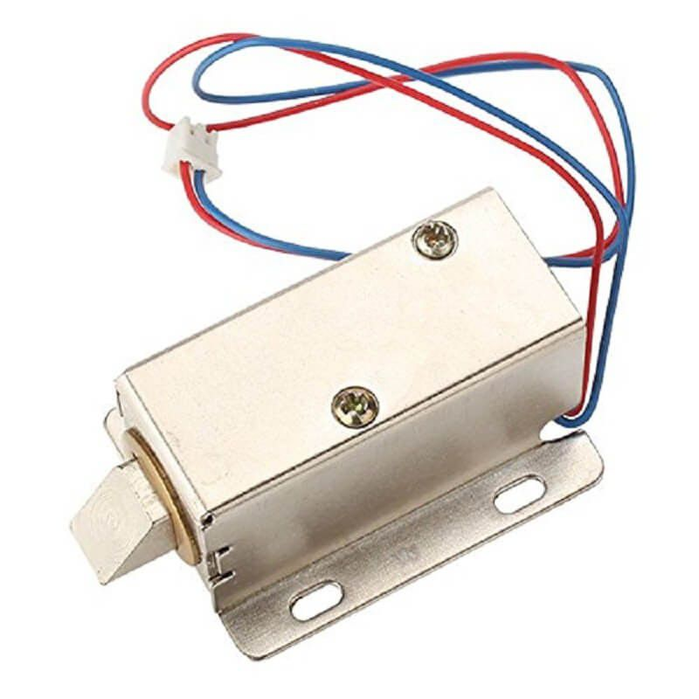
Idea 2 – door simulation
Through App
Direct control
Through Blynk API
Notes:
my next idea was to design a more convenient mode of opening my door
Rfid – replace keys
Blynk – remote access
Facial recognition – in the event I lost my phone and rfid card or my hands are filled with items

Slide 15
Notes:
Blynk unlock door

Slide 16
Notes:
Unlocking with rfid
For facial recognition, I will demo

Slide 17
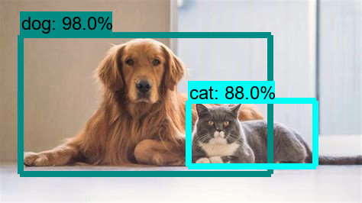

Idea 3 – Monitoring system
Notes:
For this idea, I used object detection to detect a parcel on my doorstep.
the design goes as follow…. Capture image > send image to server hosted by my computer > upload image to api > api return results
The result and image will then be displayed on my phone through telegram bot

Slide 18

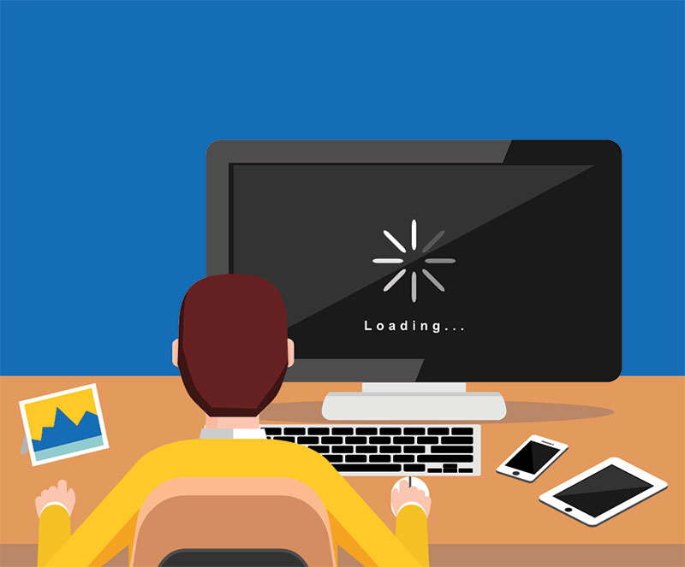
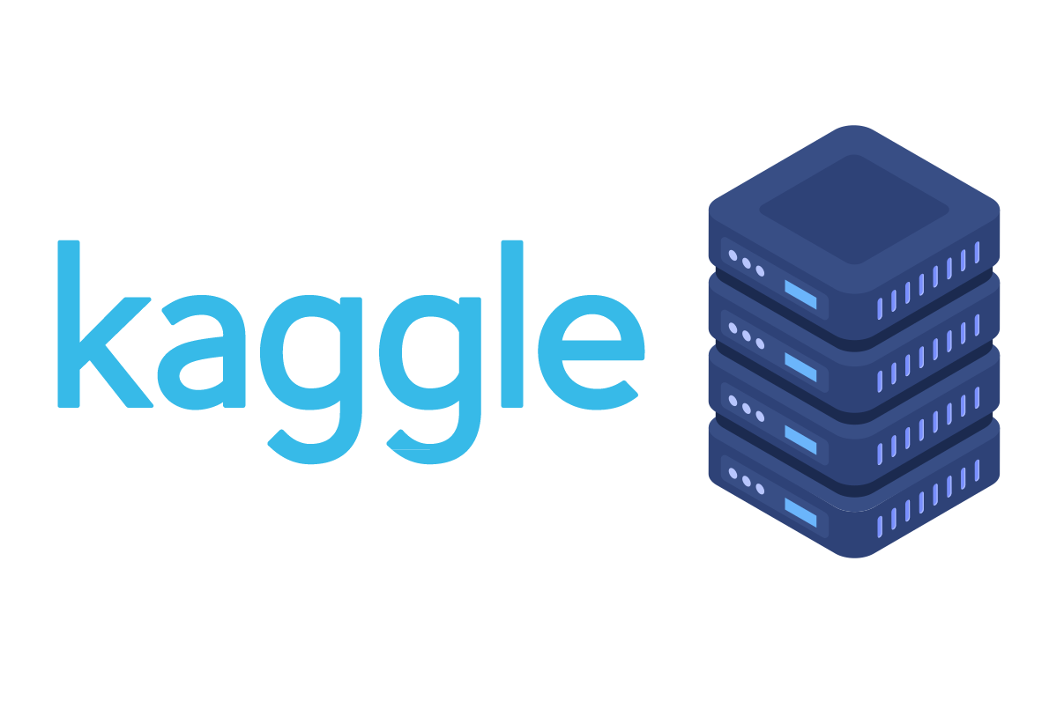
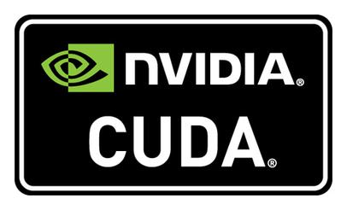
Notes:
Speaking object detection….
Traditionally, the most common method would be to use tensorflow
But need nvidia and train own dataset
But this can all be alleviated with google vision

Slide 19
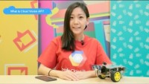

Slide 20

Notes:
The telegram bot is actually able to perform lots of task such as performing a delivery, read emails etc.
For this idea, I configure it to send message and image
For sending the message via telegram bot, the following function is used
All Through http request

Slide 21
Notes:
Result and confidence at the right
If detected what we want, alert telegram

Slide 22
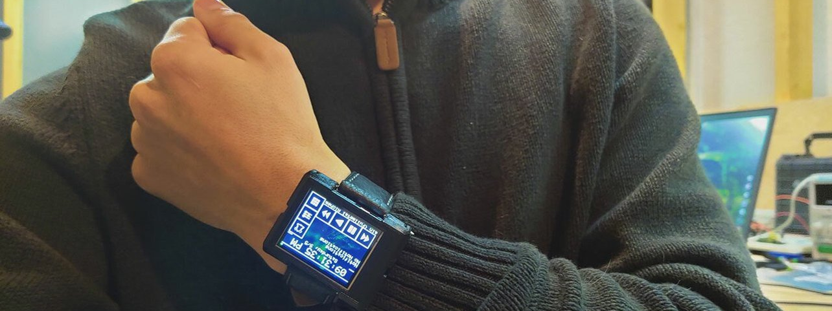
Idea 4 – remote controller
Notes:
https://github.com/Bellafaire/ESP32-Smart-Watch
Inspired by esp32 watch
More convenient to press remote control that to unlock phone and launch app

Slide 23
Notes:
Designing of the ui
Need to control pixel by pixel
Drawbitmap for buttons
Ringmeter to display sensor value

Slide 24
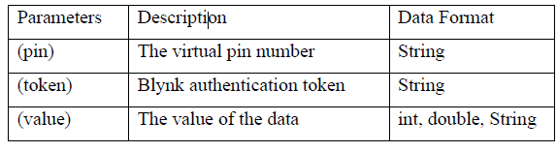
Notes:
The backend sending and reading of data using the following commands by Blynk API
Send via http

Slide 26
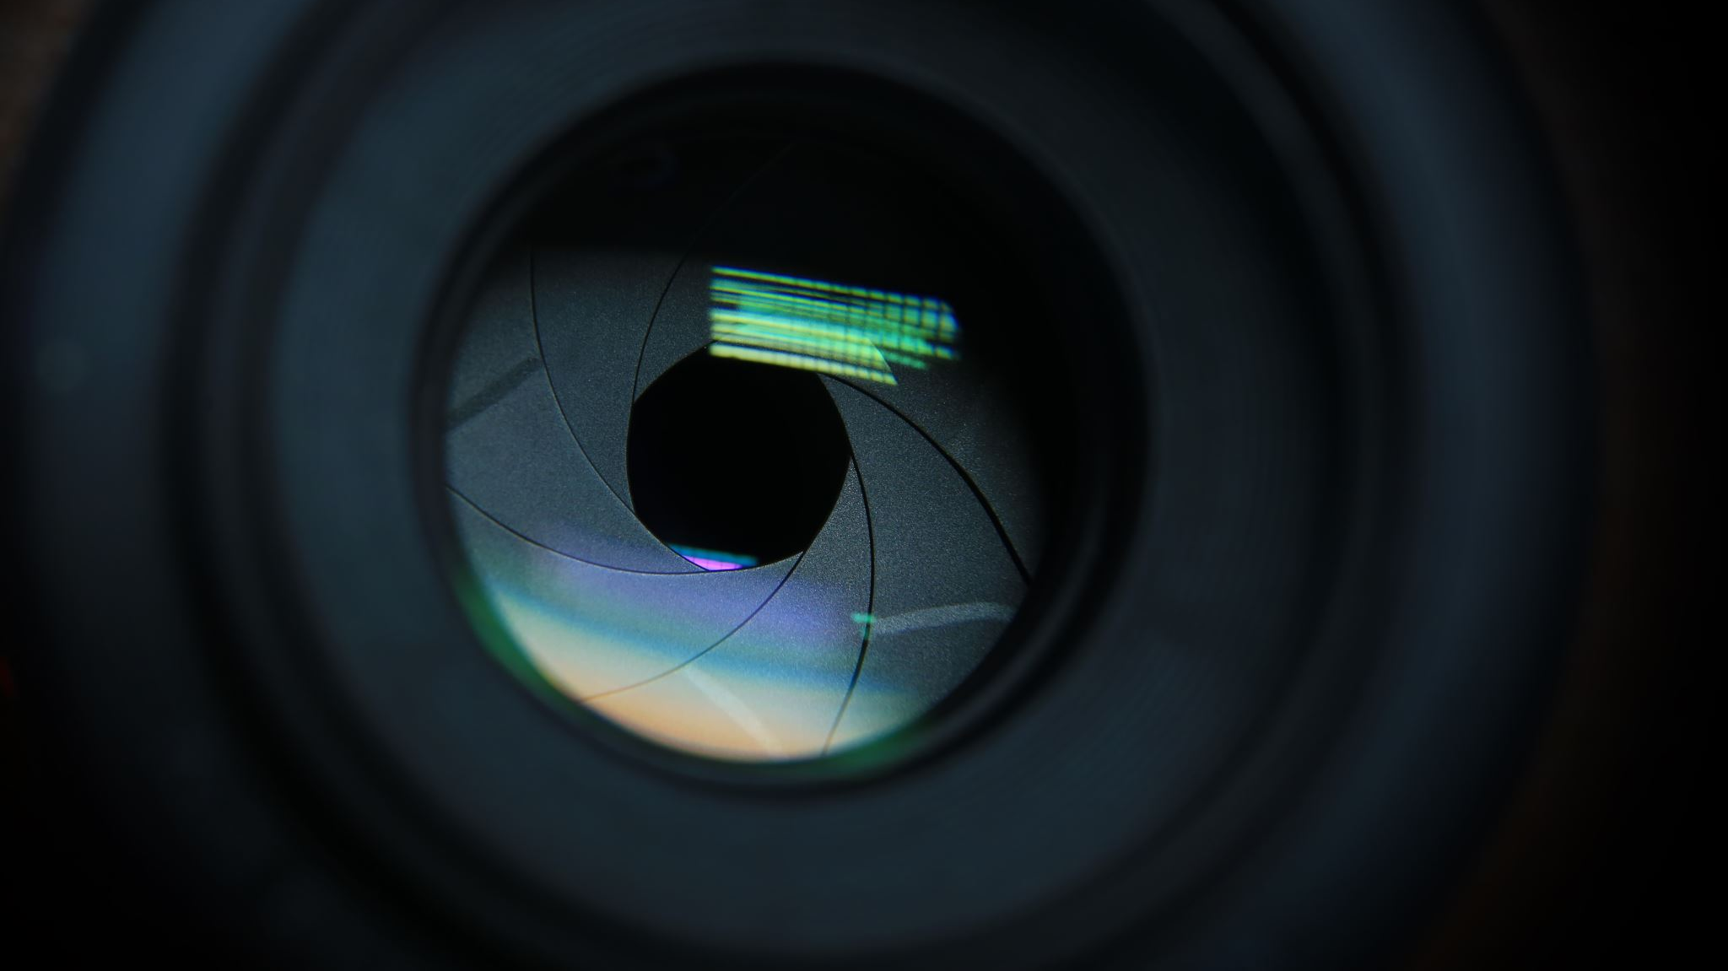
Demo

Slide 27

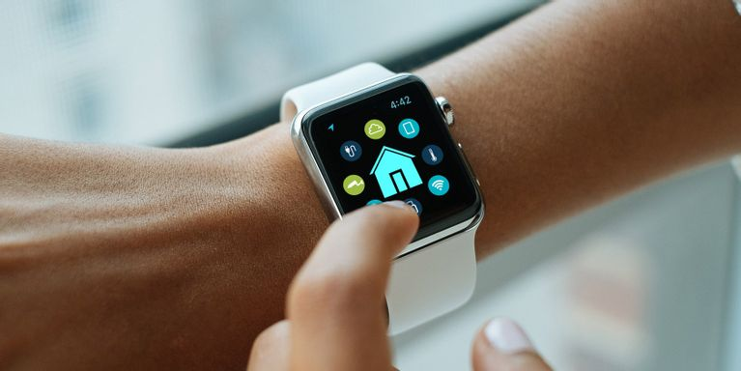
Future recommendations
Notes:
Monitoring system – incorporate more sensors (motion sensor to see visitor, water level sensor to identify leakage etc.)
Remote controller – enhance my ui and implement it to an actual esp32 watch

Slide 28
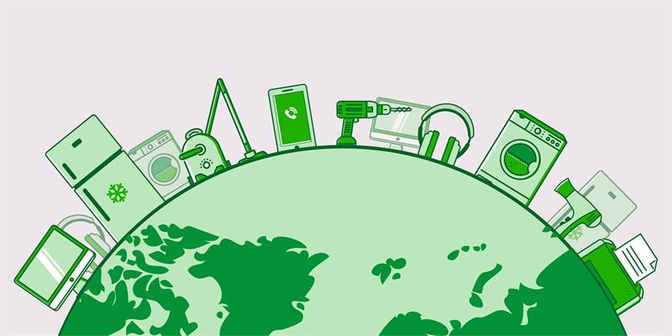
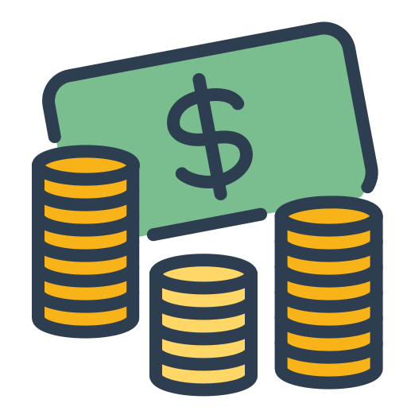


Benefits
Notes:
Reduce the need to buy new automation products
Everything can be linked to one app
Save money cheaper

